Slide 1


Project Phase -1 Presentation
on
Special Study On Fire Evacuation Of Building (Escape Chute System)
Presented by
Name Roll No.
Tejas T. Shinde A-23
Vikram D. Korhale A-11
Under Guidance of
Prof. R. B. Matkar Sir
DEPARTMENT OF CIVIL ENGINEERING TSSM’S PADMABHOOSHAN VASANTDADA PATIL INSTITUTE OF TECHNOLOGY, PUNE

Slide 2
Agenda
Project Review
Introduction
Problem Definition
Literature Review
Summary of Literature Review
Methodology
References

Slide 3
Project Review Recap
FIRE EVACUATION
(Escape chute System)
Escape chute is a special kind of emergency exit, used where conventional fire escape stairways are impractical.
Final Objectives:
To Study Mass and Rapid Emergency Evacuation.
To study Personal Safety
To Save Lives.
To evacuating a high location when all other means of emergency egress are blocked.
To Provide effective and guaranteed means of escape .

Slide 4
Introduction
Escape chute systems main aim to Saves lives and protects Property by Facilitating a speedy response to emergencies.
It Provide effective and guaranteed means of escape.
Ensures peace of mind for tenants, employers, owners and building management.
One Escape Chute can evacuate at the rate of 25 people per minute, or have 360 persons at ground level in 15 minutes, irrespective to the height.
Background
In Canada, metal tubes where installed on school building in the1800s, including the original Alexander muir public school , And at prospect and timothy streets in new market, Ontario.

Slide 5

Motivation
Every year many fire accidents occurs which causes Living Loss.
For Example;
NEWS: Mumbai rooftop pub fire kills 14, Including Women Celebrating Birthday.
NEWS: Delhi; Fire Breaks out on the 5th floor of Pandit Deendayal Bhawan At CGO Complex; All exits are Blocks .

Slide 6
Literature Review
Sr.No | Author | Year | Tital | Strength | Weakness
1. | Yao Yansheng | 2012 | Study On Escape Chute Device of High-Rise Building | Safe Escape in the Fire Disaster Of High-Rise Building.
2. | Xin Zhang | 2017 | Study On Rapid Evacuation In High-Rise Building | More And More High-Rise Building Emergency evacuation.
3. | Jönsson A, Andersson J, Nilsson D: | 2012 | A RISK PERCEPTION ANALYSIS OF ELEVATOR EVACUATION IN HIGH-RISE BUILDINGS. | In Proceedings of the 5th Human Behaviour in Fire Symposium.Interscience Communication Ltd, Cambridge, UK

Slide 7
Literature Review …
Axel Thoms :Retrieved 21 March 2013
Personal Safety Escape chute
The Personal Safety Esacpe Cute Was developed to evacuate people in a safe and speedy manner. The Evacuees direct contact with the safety chute gurantees a Smooth descent at an even speedy.
The Personal safety Escape Chute is more than suitable for the evacuation of people with disabilities as well as children over 12 kg.
8 to10 people can escape through the chute from a Height of 30 metres within 2 min. ISO 9001 Certifies the Production of the personal safety Escape Chute.
The Deceleration Rate in The personal Safety Escape Chute Equals 2.10 Metres per second. A normal Elevator has a deceleration Rate of 5 Metres per second.

Slide 8
Literature Review …
In summary, a new evacuation device is proposed and designed for high rise buildings.
Such device does not require any electric power and physical strength, with the feature of simple structure and easy to use;
It can be used not only in the high-rise building emergency evacuation for all kinds of people, but also can replace some of the vertical transportation means.

Slide 9
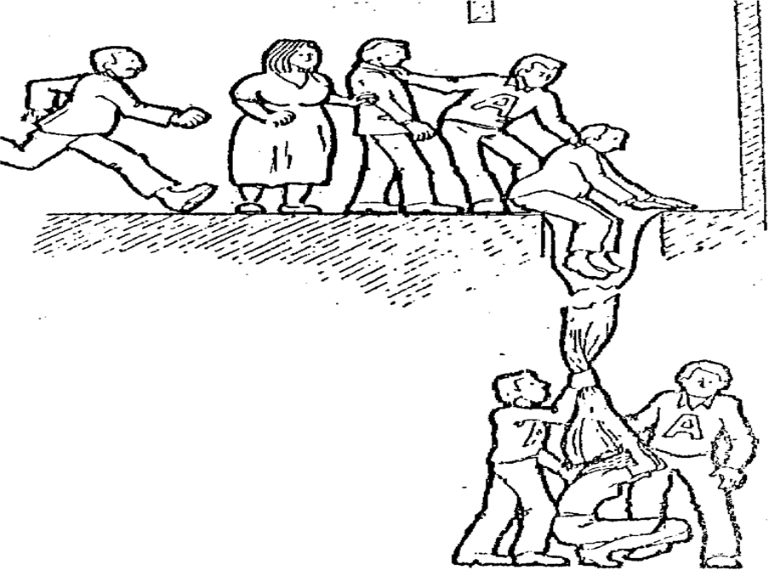
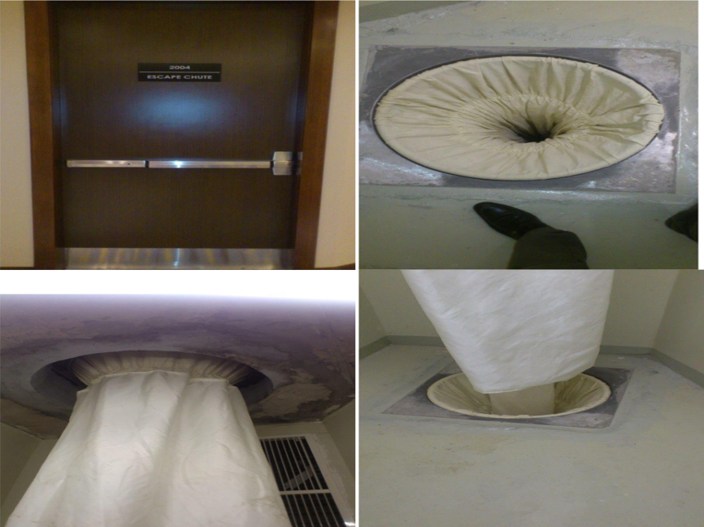
System Architecture and Design
Precinct (Small cubicle room)
The precinct is constructed with the shortest side of the wall that is of at least 1000mm and the longest side of the wall is of at least 2000mm.
The wall of the precinct must be constructed with fire resistance materials of at least RF120 (120 minutes resistant to the fire).
Materials will be of MO category. A wall having a ceramic brick of 9cm thickness protected with chalk both sides are considered as acceptable .

Slide 10
Project Design …
Civil Engineering Requirements
Inside the precinct (small cubicle room), cut a square hole on the concrete floor to fit the square aluminum alloy chute mounting frame and the chute.
The square holes and the Slabs within the Fire Chute duct will be fabricated as shown on the Fire Chute Design submitted by us.
Chute Fabrics
The escape chute installation consist 2 layers of chute fabrics:
(A)Internal layer is made up of Aramid/Twaron fabric for resistant.
This layer allows person smooth sliding inside chute and the friction is low enough that no serious injuries are caused.
(B) External layer is made up of Spun cell elastic, for breaking the speed of descent.

Slide 11
Methodology
Identify the key behavioral factors affecting the performance of people during a fire in a high-rise building.
Review the procedures and strategies currently adopted in high-rise buildings
Modeling case studies
This section reviews a set of relevant studies performed to analyze high-rise building evacuation scenarios through computer modeling.
To Study of Structure design of equipment.
The new flexible escape chute has many innovations, such as, many sections, multi entrance, the function of store and release, fire-proof and high temperature-proof and so on, which can make the survivals escape from the nearest place safely and effectively.

Slide 12
Summary
It shows advantages of saving power energy, reducing the number of elevators, and decreasing the total project cost.
As We See India has a history of Fire Accidents, so for such cases Safe, Effective and guaranteed means of escape Is Essential.
It shows advantages of saving power energy, reducing the number of elevators, and decreasing the total project cost.

Slide 13
References
BOOK:
1. Emergency Evacuation Planning For Your Workplace; From Chaos to Life-Saving Solutions Hardcover- August 1, 2013 by Jim Burtles (Author), Kristen Noakes-Fry (Editor)
2.Fire Safety Refrence Guide For Supervised Community Residences
Booklet 2.Evacuation Planning, By New York State Of Opportunity

Slide 14
Thank You
Q/A ---------------------------------- ?

